Slide 1


Slide 2
Final Project
Online Academic Management System

Slide 3
Introduction
Submitted By :
*****************
Roll # MCE IT 11-42
****************
Supervised By:
Sir Sher Jamal
**************

Slide 4
Introduction Of AMS
This system is designed in favor of the record management which helps them to save the records of the student and other things. It helps them from the manual work from which it is very difficult to find the record of the student and the assignments, time table and date sheet etc., and the information about the teachers.
I design this system for the management of computer science department in BZU, through this they cannot require so efficient person to handle and calculate the things manually. This system show all the data required by student of computer science department.

Slide 5
Project goals and objectives
Goals:
Elimination of paper work for appointment.
Reduce the time and save the money.
All student record, teacher record would be kept and can see any time by using their login..
Correctness.
Maintainability.
users needs.

Slide 6
Project goals and objectives
Objectives:
Online management of student record, to improve and promote them is the basic objective of this project.
It will also provide an online record and catalogue of assignments, time table ,date sheet , attendance and information required by providing an operating online database.
Increasing the efficiency, saving time and removing human errors during recording stock data.
Providing accurate information for any student when required.

Slide 7
HSM Scope and Reports
Scope of the system
Providing security .
Generate receipt
Generating reports
Reports
Result report
Date Sheet report
Time Table Report

Slide 8
Description & Drawbacks of existing system
Description of existing system :-
The system at present working manually ,that means all the Record is maintained manually which may lead to error and slow work thus the management needs to transfer the system as a computerized system.

Slide 9
Description & Drawbacks of existing system
Drawbacks of existing system:-
- Difficulty in maintenance of records. - Time consuming. - Editing of becomes a tedious job. - No security of data. - Mistake occurring in long calculations. - Not proper generation of reports. - High data redundancy. - Data inconsistency. - Record can not be search easily

Slide 10
Description of proposed system
Reduced manual work by generating report
Proposed system is user friendly so it is easy to operate
Save time
Ensure data security
System is helpful to see the present status of stock
Fast and accurate output generation

Slide 11
Tool Selection
Selection of the appropriate software is most crucial stage of the development phase. The choice of software tool should be done in keeping view of the problem faced in order to avoid heavy loss of time and money. Tools used for any system development are:
1. Hardware
2. Software

Slide 12
Tool Selection
Hardware:-
For the development and designing of website we had used better hardware for better functioning of the operating system and faster loading of programs. Hardware required to run this system will be:
Machine Intel CORE i3
Processor Intel(R) Core(TM) i3-2370M CPU @ 2.40GHz
RAM 2 GB

Slide 13
Tool Selection
Software:-
Any hardware without software is seemed to be useless in this environment. So different types of software are considered for this specific purpose. Chosen ones are:
Operating System Windows 7/Windows 8
Front end tool HTML, CSS
Back end tool PHP , Java script
Graphic Designing tool Dreamweaver CS6
Database MS SQL
Tools for documentation MS Word

Slide 14
Tools Used for development
Tools and Using Reasons :-
PHP
For making interface and coding.
My SQL
To keep the record of users and their details also for maintaining User personal data for booking request.
MS Word
For ERD diagram, For Use Case diagram ,System Sequence diagram, Sequence diagram.

Slide 15
Tools Used for development
Tools and Using Reasons :-
CSS
For Style.
Java Script
For handle events and form validation.
Dreamweaver CS6
For making interfaces /front –end and admin panel.
HTML
For front end page management.

Slide 16
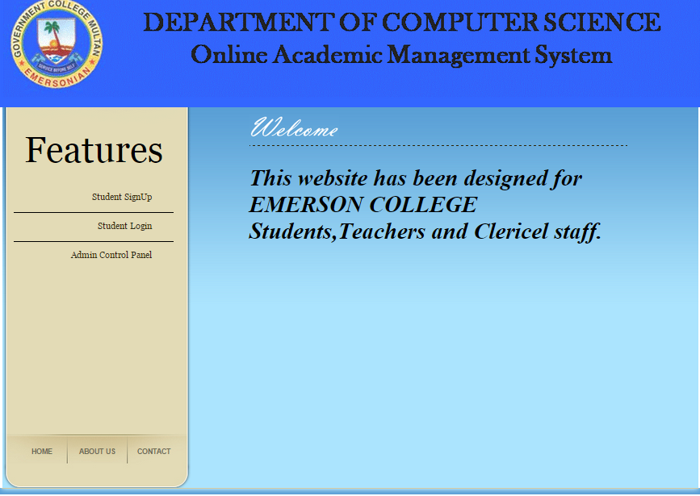
Main page Interface

Slide 17
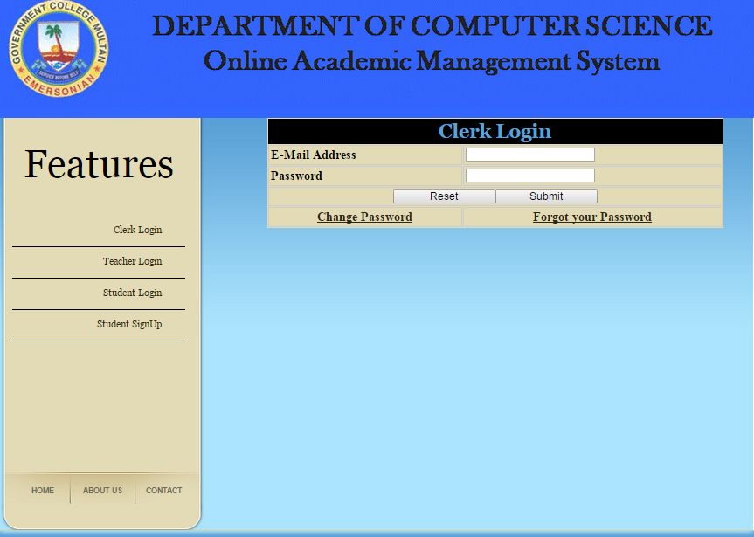
Clerk login Interface

Slide 18
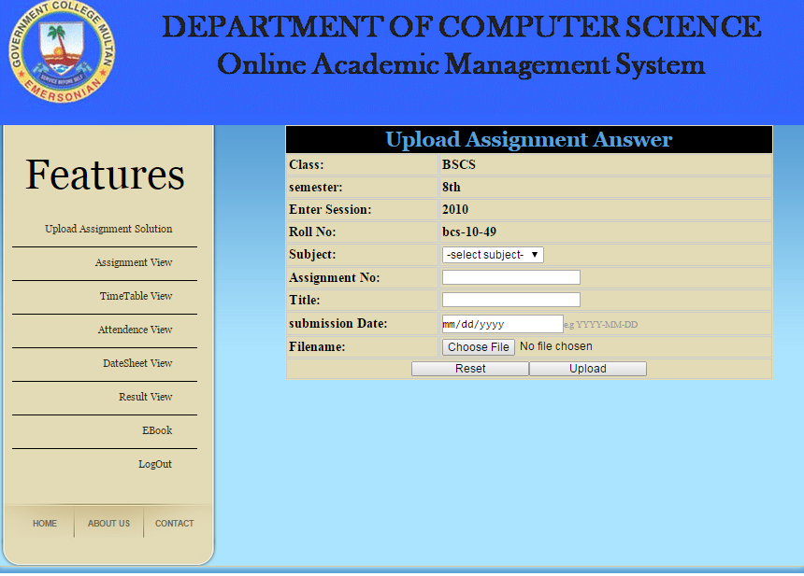
Upload assignment answer interface

Slide 19
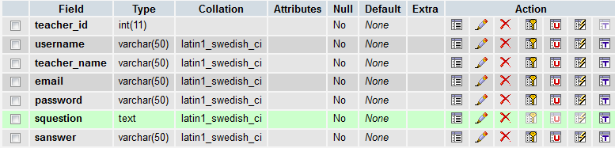
Teacher Data Base

Slide 20
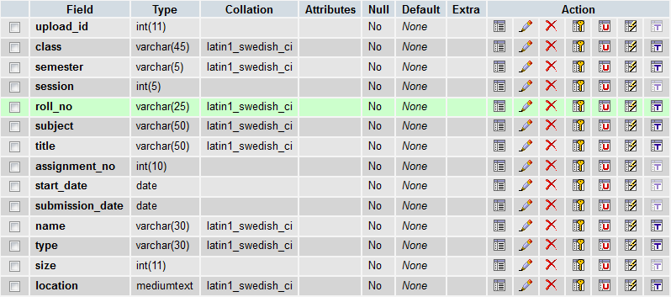
Student Assignment Data Base

Slide 21
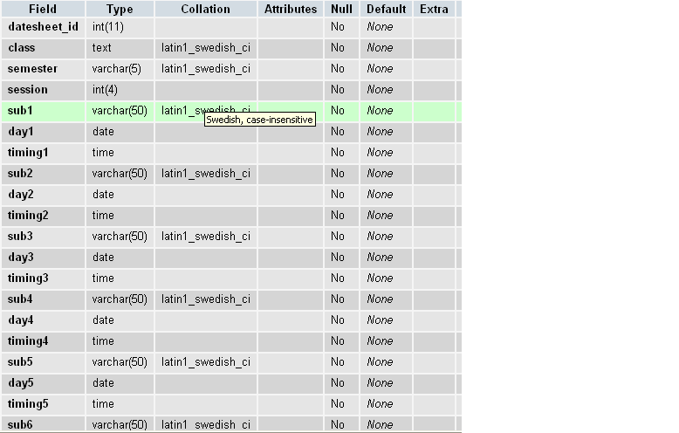
Date Sheet Data Base

Slide 22


